Slide 1

Sharp Injury Prevention

Slide 2
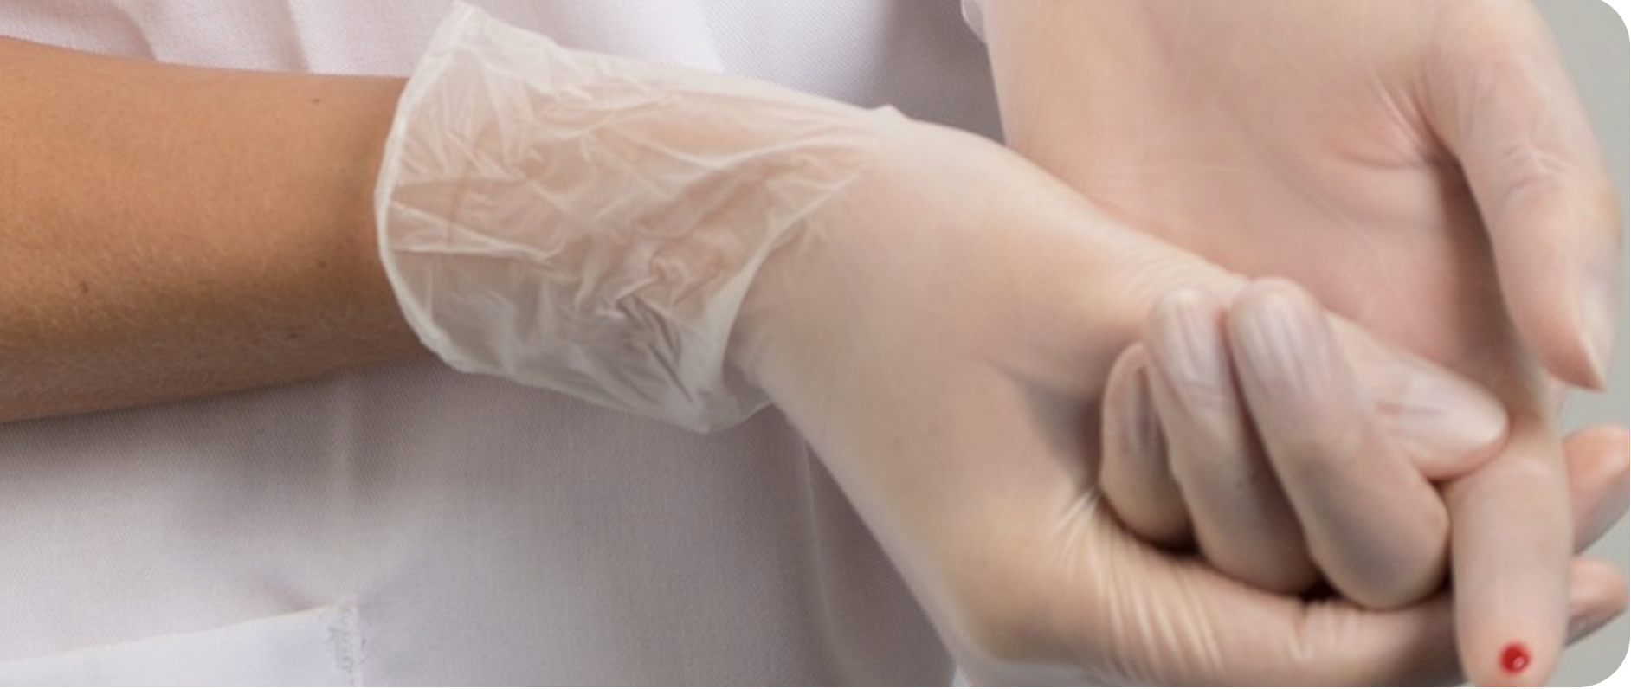
Needlestik and Sharp Injuries
Needlestik and sharp injuries are accidental skin penetrating wounds caused by sharp instruments in a medical setting.
A break of skin can be from a needle or other ‘sharp’ such as a scalpel/glass

Slide 3
Why sharp safety matters?
Each year, an estimated 1.2 million needlestick injuries (NSIs) occurred in Europe before the Covid pandemic.
According to WHO: 2 million exposures per year In Healthcare workers: • 30 % of Hepatitis B • 03 % of Hepatitis C • 0.3 % of HIV
The CDC estimates that each year 385,000 needlesticks and other sharps-related injuries are sustained by hospital-based healthcare personnel; an average of 1,000 sharps injuries per day. The true magnitude of the problem is difficult to assess.
Surveys of healthcare personnel indicate that 50% or more do not report their occupational percutaneous injuries.

Slide 4
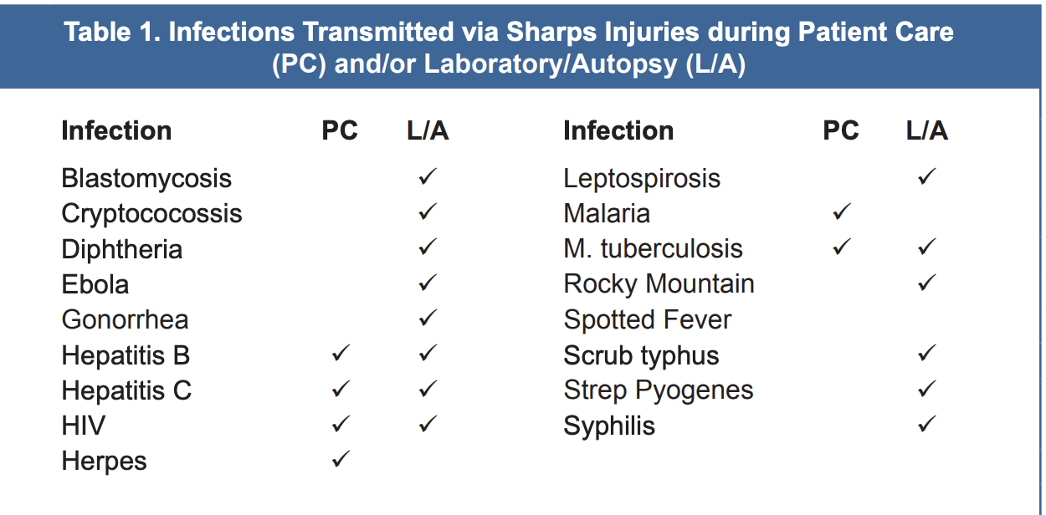
Prevention of percutaneous injuries and other blood exposures is an important step in preventing the transmission of bloodborne viruses to healthcare workers.
Bloodborne Virus Transmission to Healthcare Personnel

Slide 5
Consequences of sharp injuries:
pain and anxiety
post-exposure testing and medication
lost of work time
İncreased cost
Long term consequences
PREVENTABLE

Slide 6
Common causes of sharp injuries
Recapping used needles
Improper disposal of sharps
Rushing or multitasking during injections
Passing sharps between staff
Not using safety- engineered devices
Overfilled sharps containers

Slide 7
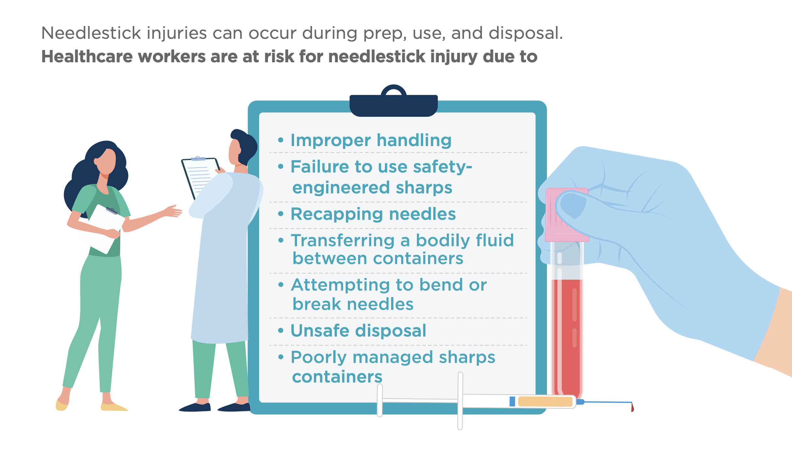
Sharp safety is the best practice

Slide 8
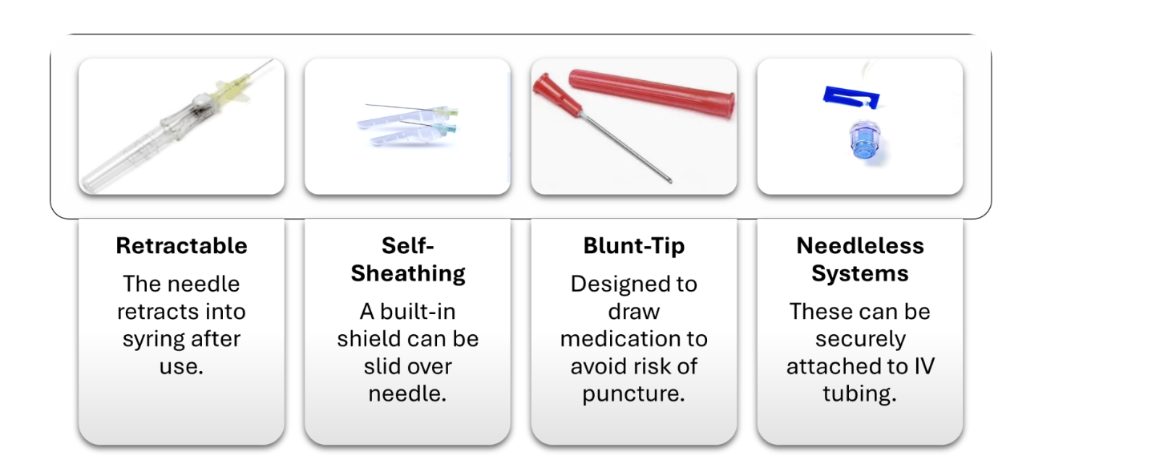
Sharp safety best practices:
Always choose needels and scalpels with retractable or self- sheathing features

Slide 9
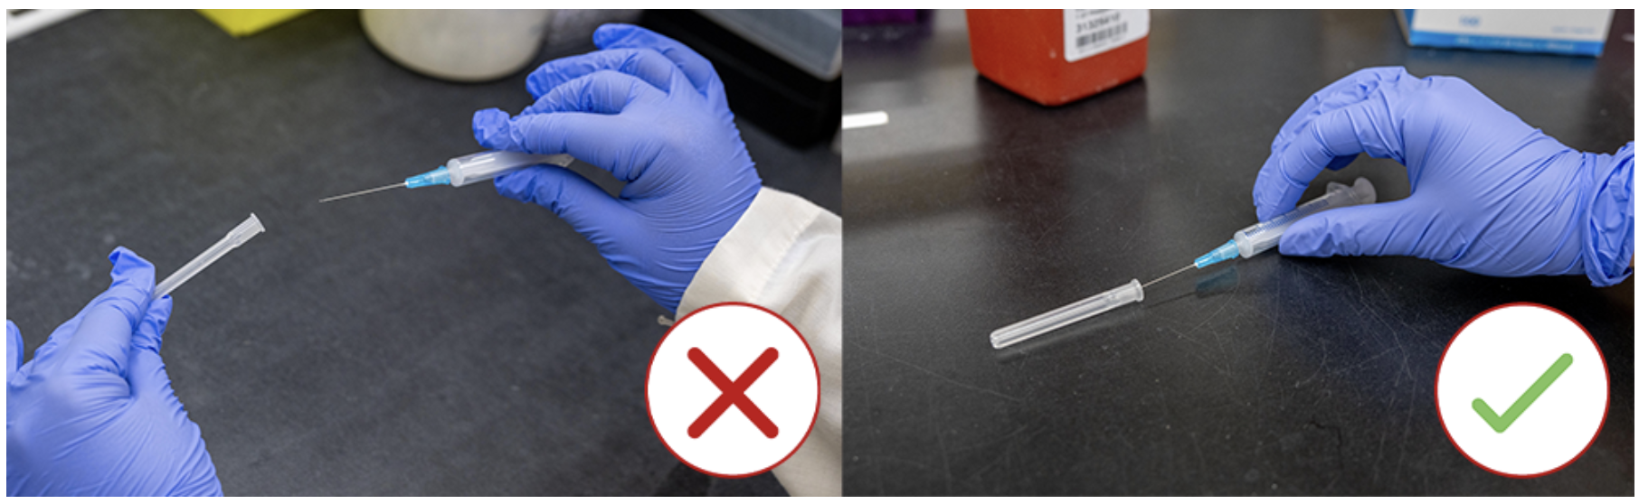
Never recap used needles. This is the most dangerous practices. Use the one-hand scoop only if recapping is absolutely necessary, per policy.

Slide 10
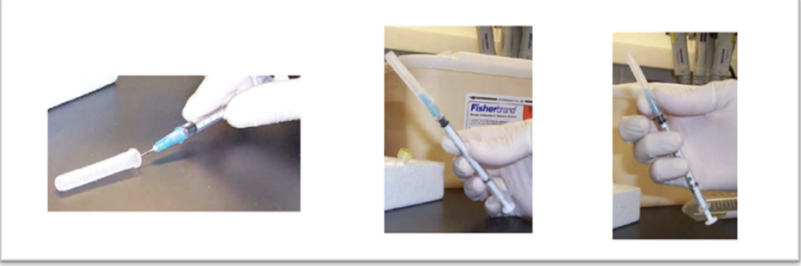
One-handed “Scoop” Technique
Steps:
First, place a cap on a level and tidy surface.
Gently slide the needle halfway into the cap.
Slowly tip up the needle end of the device and allow the cap to slide onto the needle.
Use your thumb on the hand holding the device to secure the cap on the syringe.

Slide 11
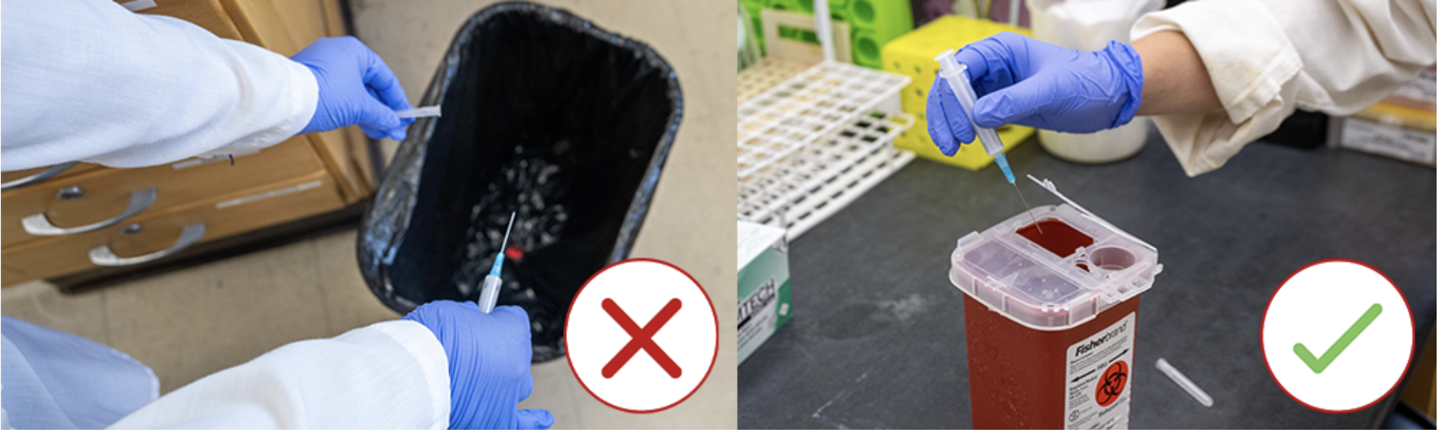
Dispose of sharps immediatly after use

Slide 12
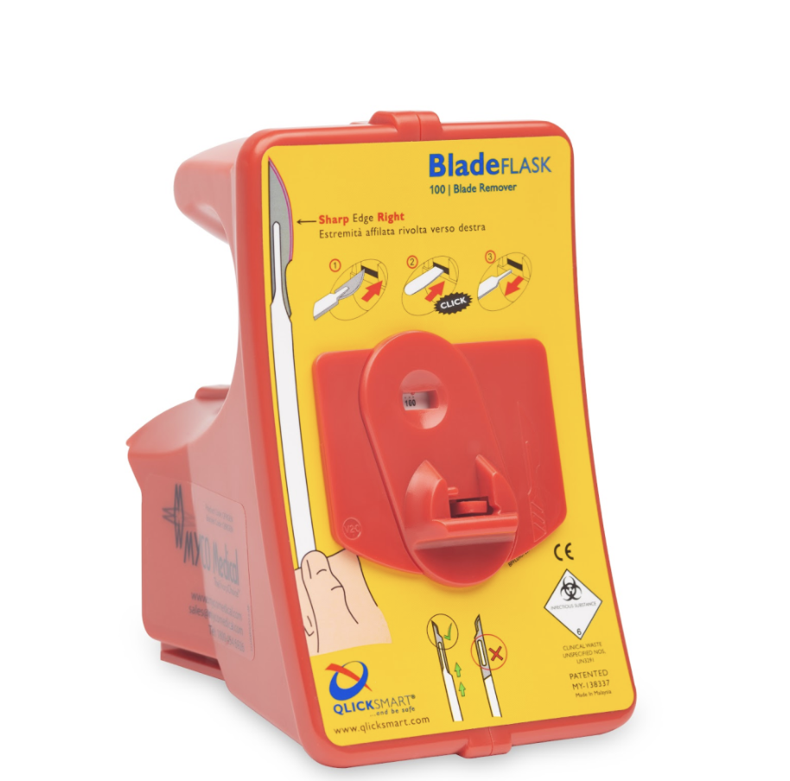
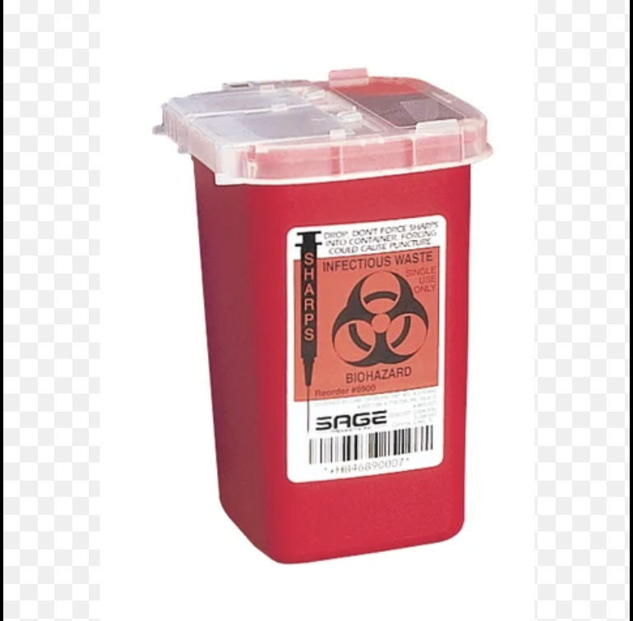
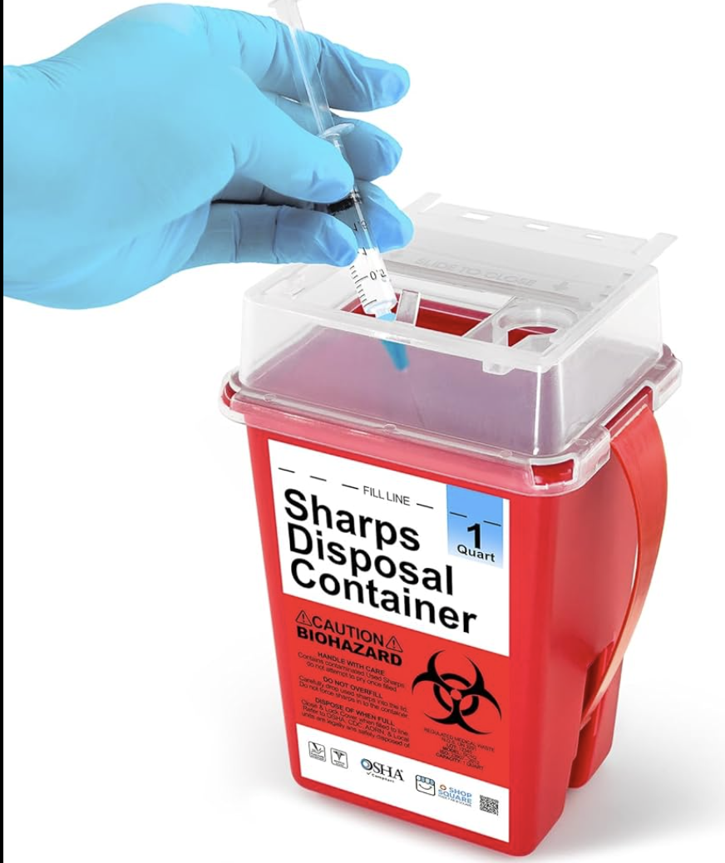
Use puncture- resistant, leak- proof sharps containers.

Slide 13
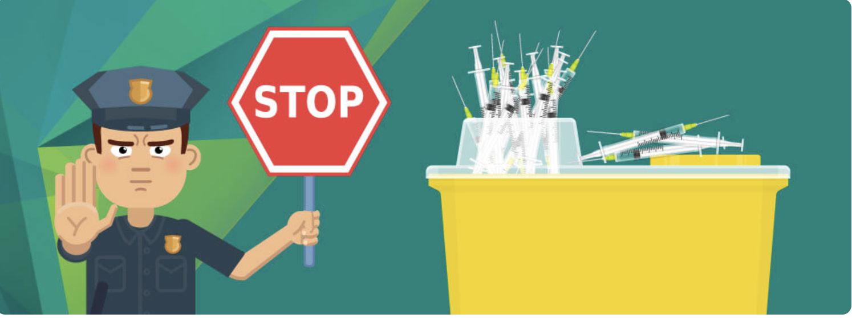
Don’t carry sharps in pockets.
Drop needels into containers at the point of care
Dispose when containers are tree- quarters full.

Slide 14
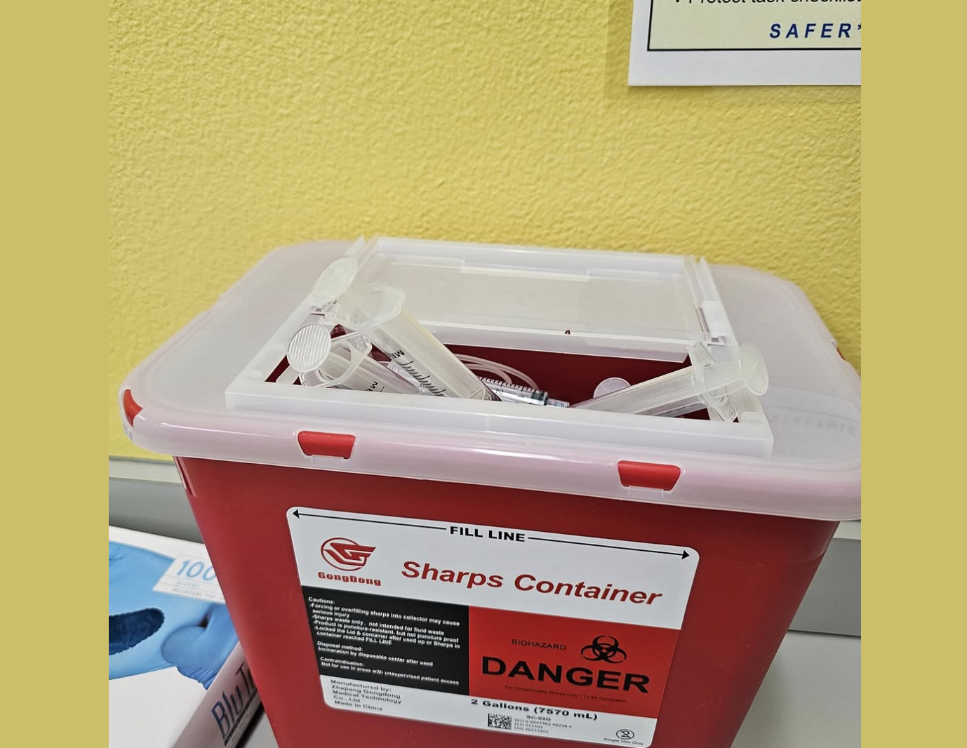
Never push or force sharps into a full container

Slide 15
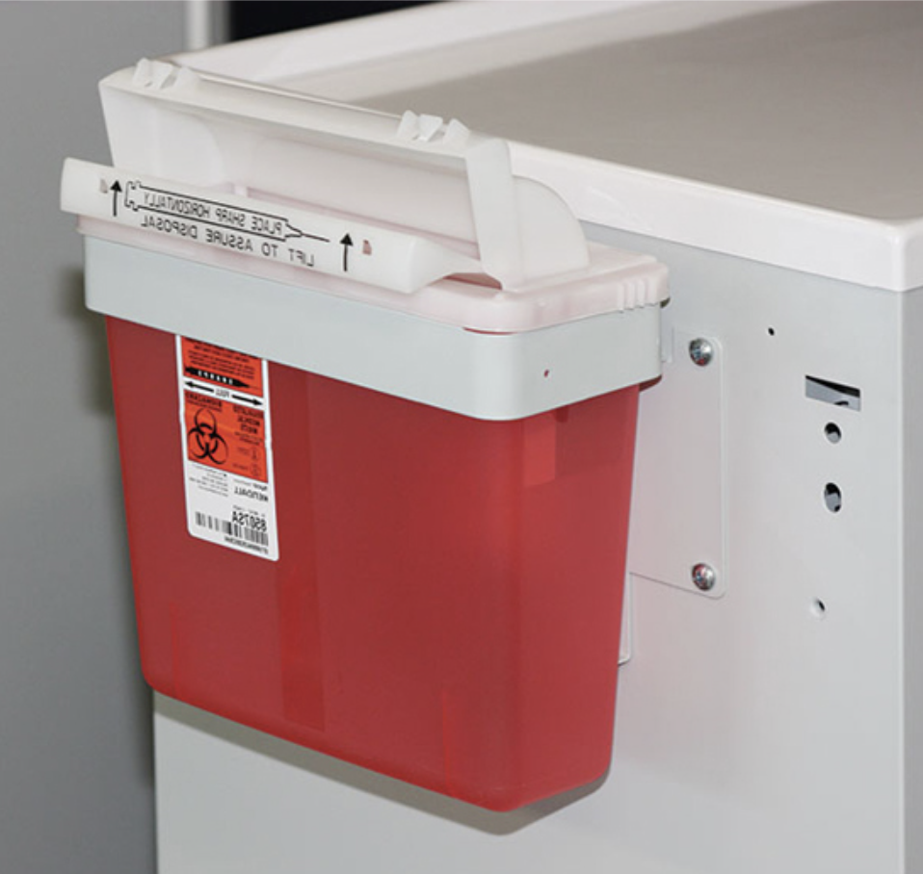
Place sharps containers within arm’s reach in all patient care areas.
Use wall-mounted or portable options as needed.

Slide 16
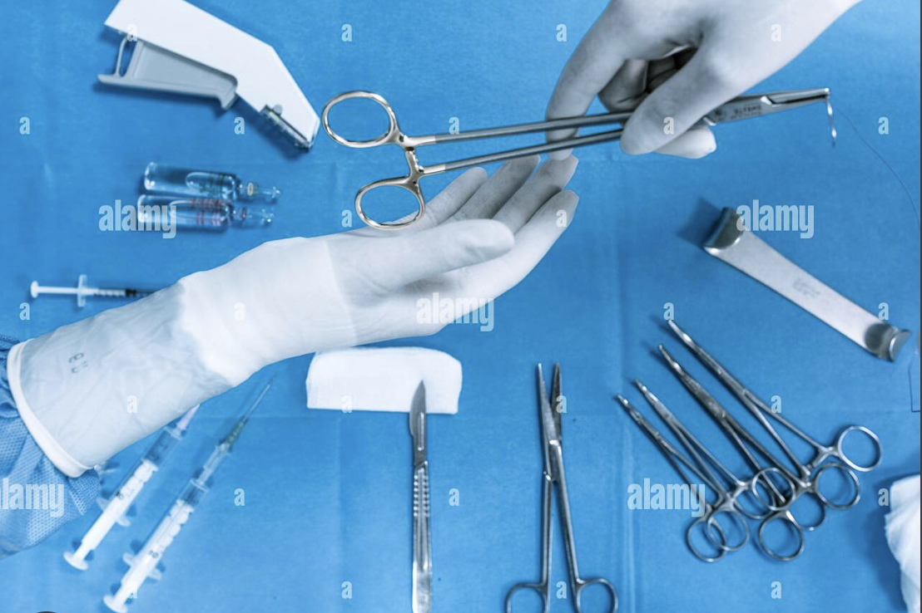
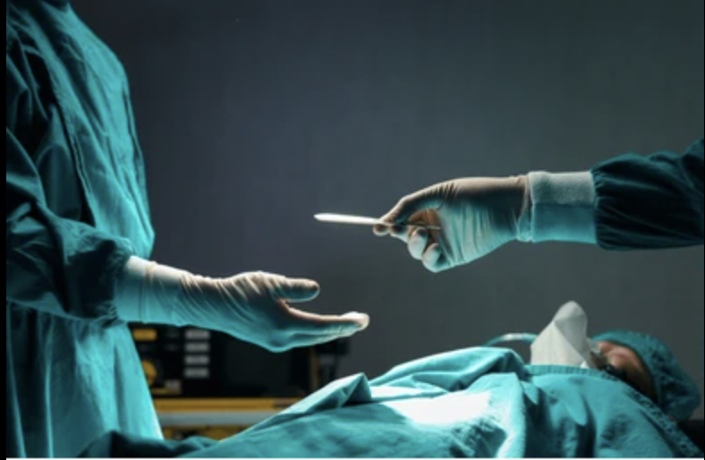
Use a neutral zone when passing sharps.
Say: 'Sharp’before handling over scalpels or needels in surgery or bedside procedures.

Slide 17
SLOWİNG DOWN, BEİNG MİNDFUL AND FOLLOWİNG PROTOCOL SAVES YOU AND YOUR TEAM FROM UNNECESSARY INJURY.

Slide 18
What to do if you get injured?
WASH THE AREA IMMEDİATELY. USE SOAP AND WATER
DO NOT SQUEEZE OR SCRUB THE WOUND
REPORT THE INJURY RİGHT AWAY
TELL YOUR SUPERVİSOR AND GO TO EMPLOYEE HEALTH OR EMERGENCY ROOM.

Slide 19
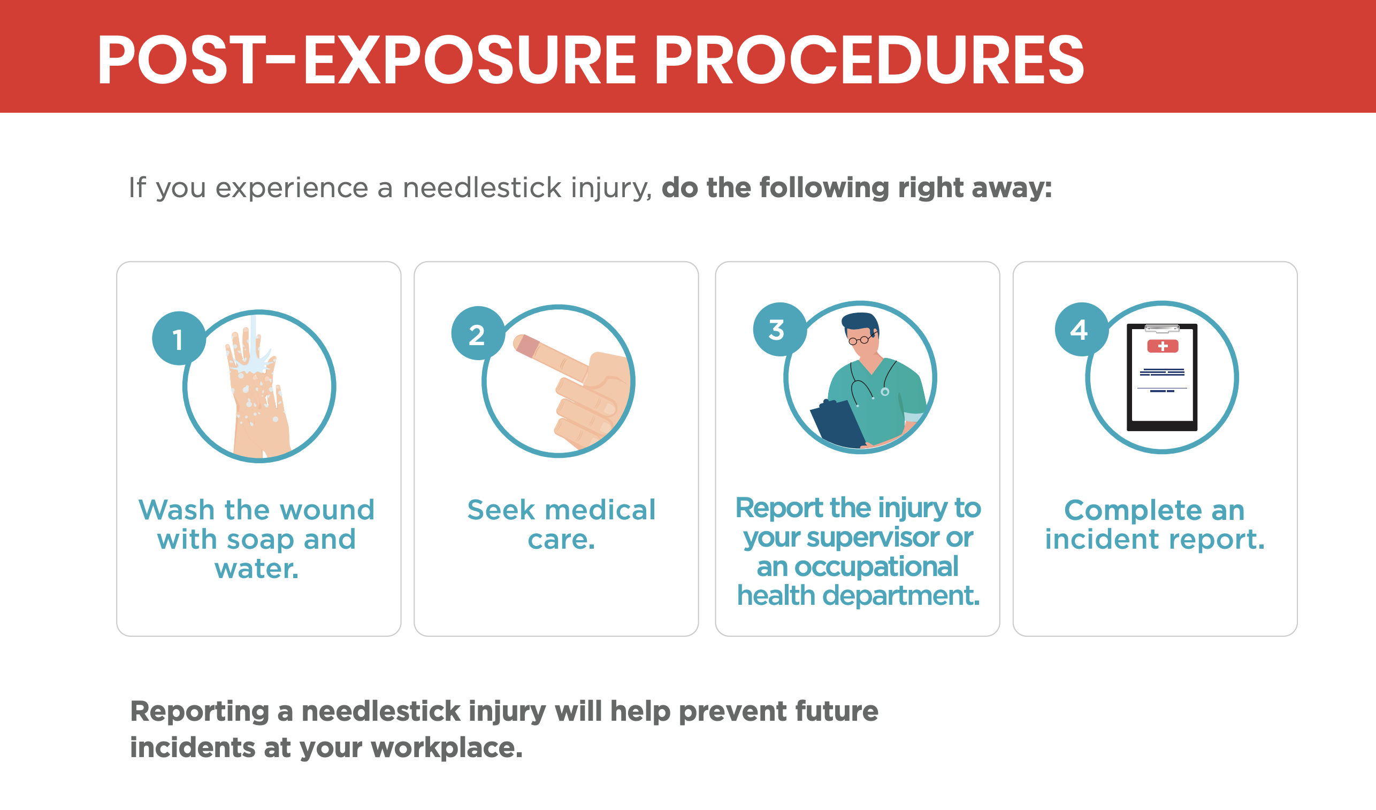

Slide 20
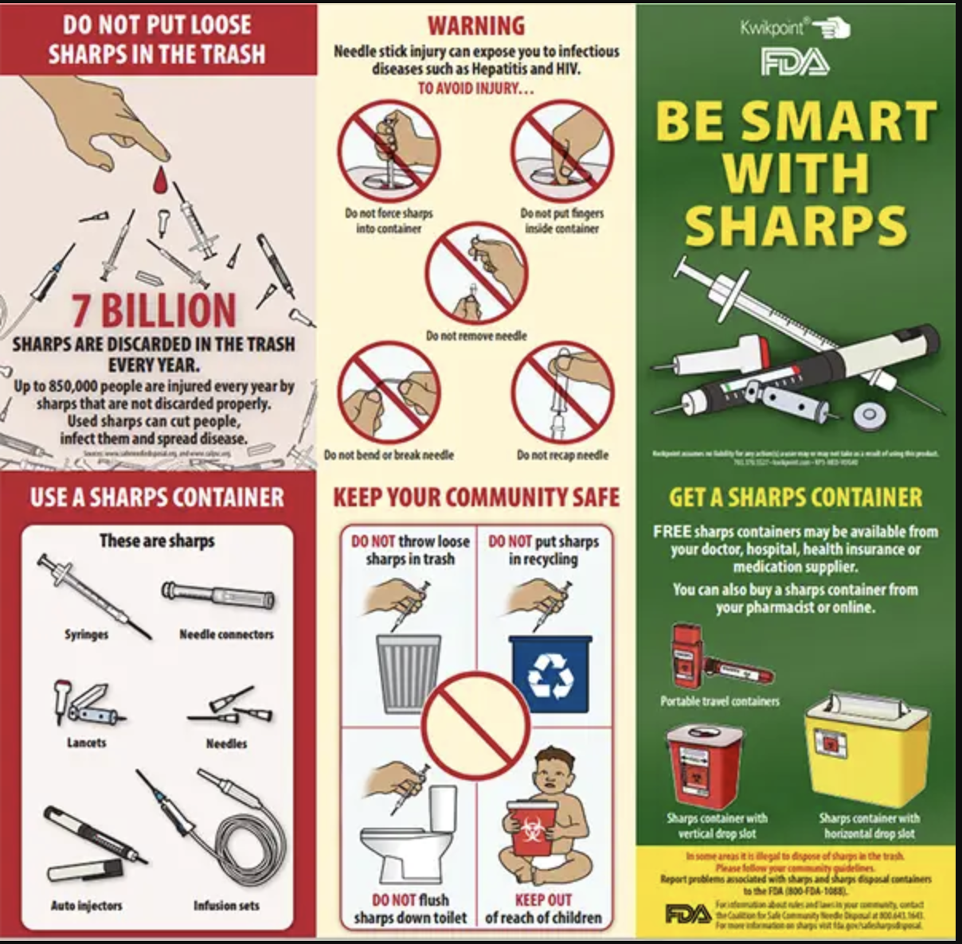
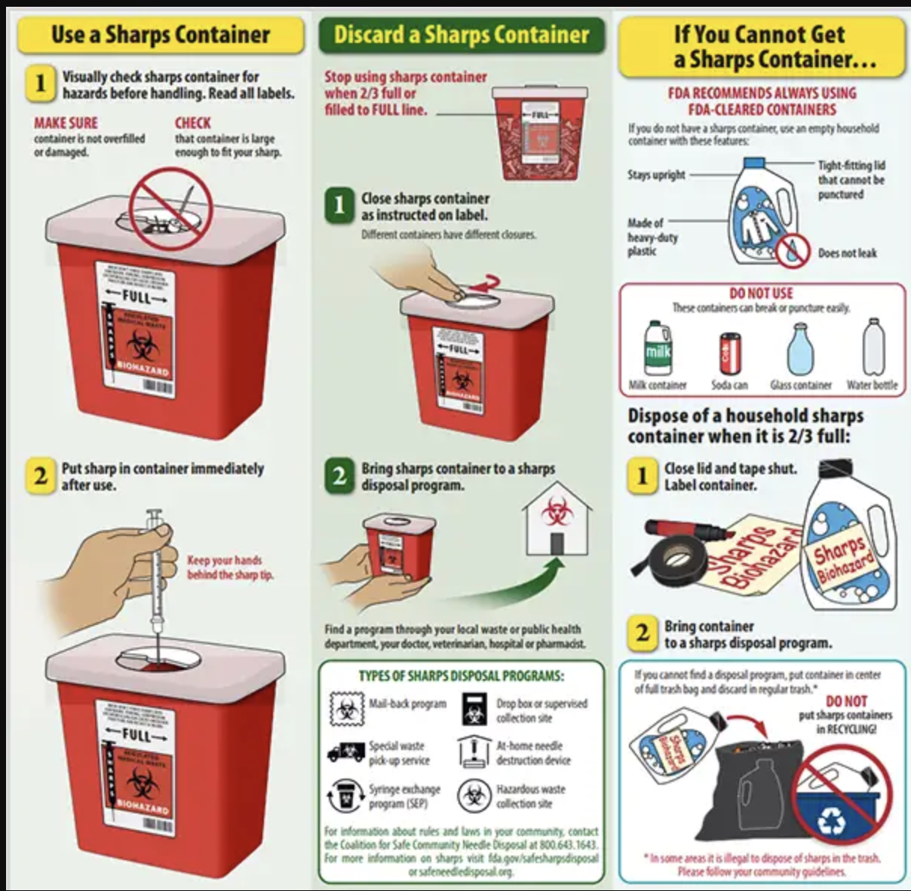

Slide 21
Post- exposure
You will need to report:
How the needlestick or fluid exposure occurred
What type of needle or instrument you were exposed to
What fluid you were exposed to (such as blood, stool, saliva, or other body fluid)
How long the fluid was on your body
How much fluid there was
Whether there was blood from the person visible on the needle or instrument
Whether any blood or fluid was injected into you
Whether the fluid touched an open area on your skin
Where on your body the exposure was (such as skin, mucous membrane, eyes, mouth, or somewhere else)
Whether the person has hepatitis, HIV, or methicillin-resistant Staphylococcus aureus (MRSA)

Slide 22
An accidental needle stick or sharp injury is stressful, but acting quickly and following protocol significantly reduces risk. If the source patient is known to be positive for HIV or HCV, time is of the essence—especially for HIV prophylaxis.
1. Immediate First Aid
Wash the site: Clean the wound immediately with soap and water.
Flush mucous membranes: If blood splashed in your eyes, nose, or mouth, flush extensively with water or saline.
Do not "milk" the wound: Avoid squeezing the site aggressively or using harsh chemicals like bleach, as this can cause tissue damage and potentially increase inflammation.

Slide 23
2. Immediate Reporting and Assessment
Contact your Occupational Health Department or Emergency Room immediately. You need a formal risk assessment based on:
The type of sharp (hollow-bore needles are higher risk than solid needles).
The depth of the injury.
The viral load of the source patient (if known).

Slide 24
HIV Post-Exposure Prophylaxis (PEP)
Timing: To be most effective, PEP should be started within 2 hours, and no later than 72 hours post-exposure.
Duration: A standard course of antiretroviral medication lasts 28 days.
Effectiveness: When taken correctly, PEP is highly effective at preventing HIV infection after exposure.

Slide 25
Hepatitis C (HCV)
Prophylaxis: Unlike HIV, there is no recommended PEP (immunoglobulin or antivirals) for HCV.
Management: The strategy is "watchful waiting" with early detection. If you do contract HCV, modern Direct-Acting Antiviral (DAA) treatments are incredibly effective (95%+ cure rate), but they are started only if a chronic infection is confirmed.

Slide 26
Pathogen | Baseline | Follow-up Schedule
HIV | Antibody/Antigen test | 6 weeks and 4 months (or 6 months depending on facility)
HCV | HCV Antibody & RNA | 3 weeks (RNA) and 4–6 months (Antibody)

